Slide 1


UNIVERSITY OF PADUA
UNIVERSITA’ DEGLI STUDI DI PADOVA
Designing an accessibility learning toolkit -
Bridging the gap between guidelines and implementation
Department of Mathematics “Tullio Levi-Civita”
Master Degree in Computer Science
Graduate: Gabriel Rovesti
Supervisor: Prof. Ombretta Gaggi
Graduation Session: 25/07/2025

Slide 2
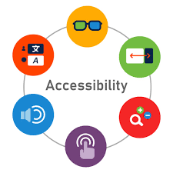

First and not least: Mobile accessibility
Definition: Ability for users to fully perceive, understand, navigate, and interact with digital content regardless of capabilities
The mobile reality:
1.3 billion people worldwide live with disabilities (WHO, 2023)
Mobile-first era: 6.8 billion smartphone users globally
Mobile interfaces create new accessibility barriers for assistive technology users
G. Rovesti - Designing an accessibility learning toolkit
2/17

Slide 3


First and not least: Mobile challenges
Touch interaction barriers:
Target size not standardized and difficult to use
Complex gestures might exclude different categories of users
One-handed operation limitations
Mobile context issues:
Small screens affect content hierarchy
Orientation changes disrupt navigation
Performance impact on battery and processing
G. Rovesti - Designing an accessibility learning toolkit
3/17

Slide 4
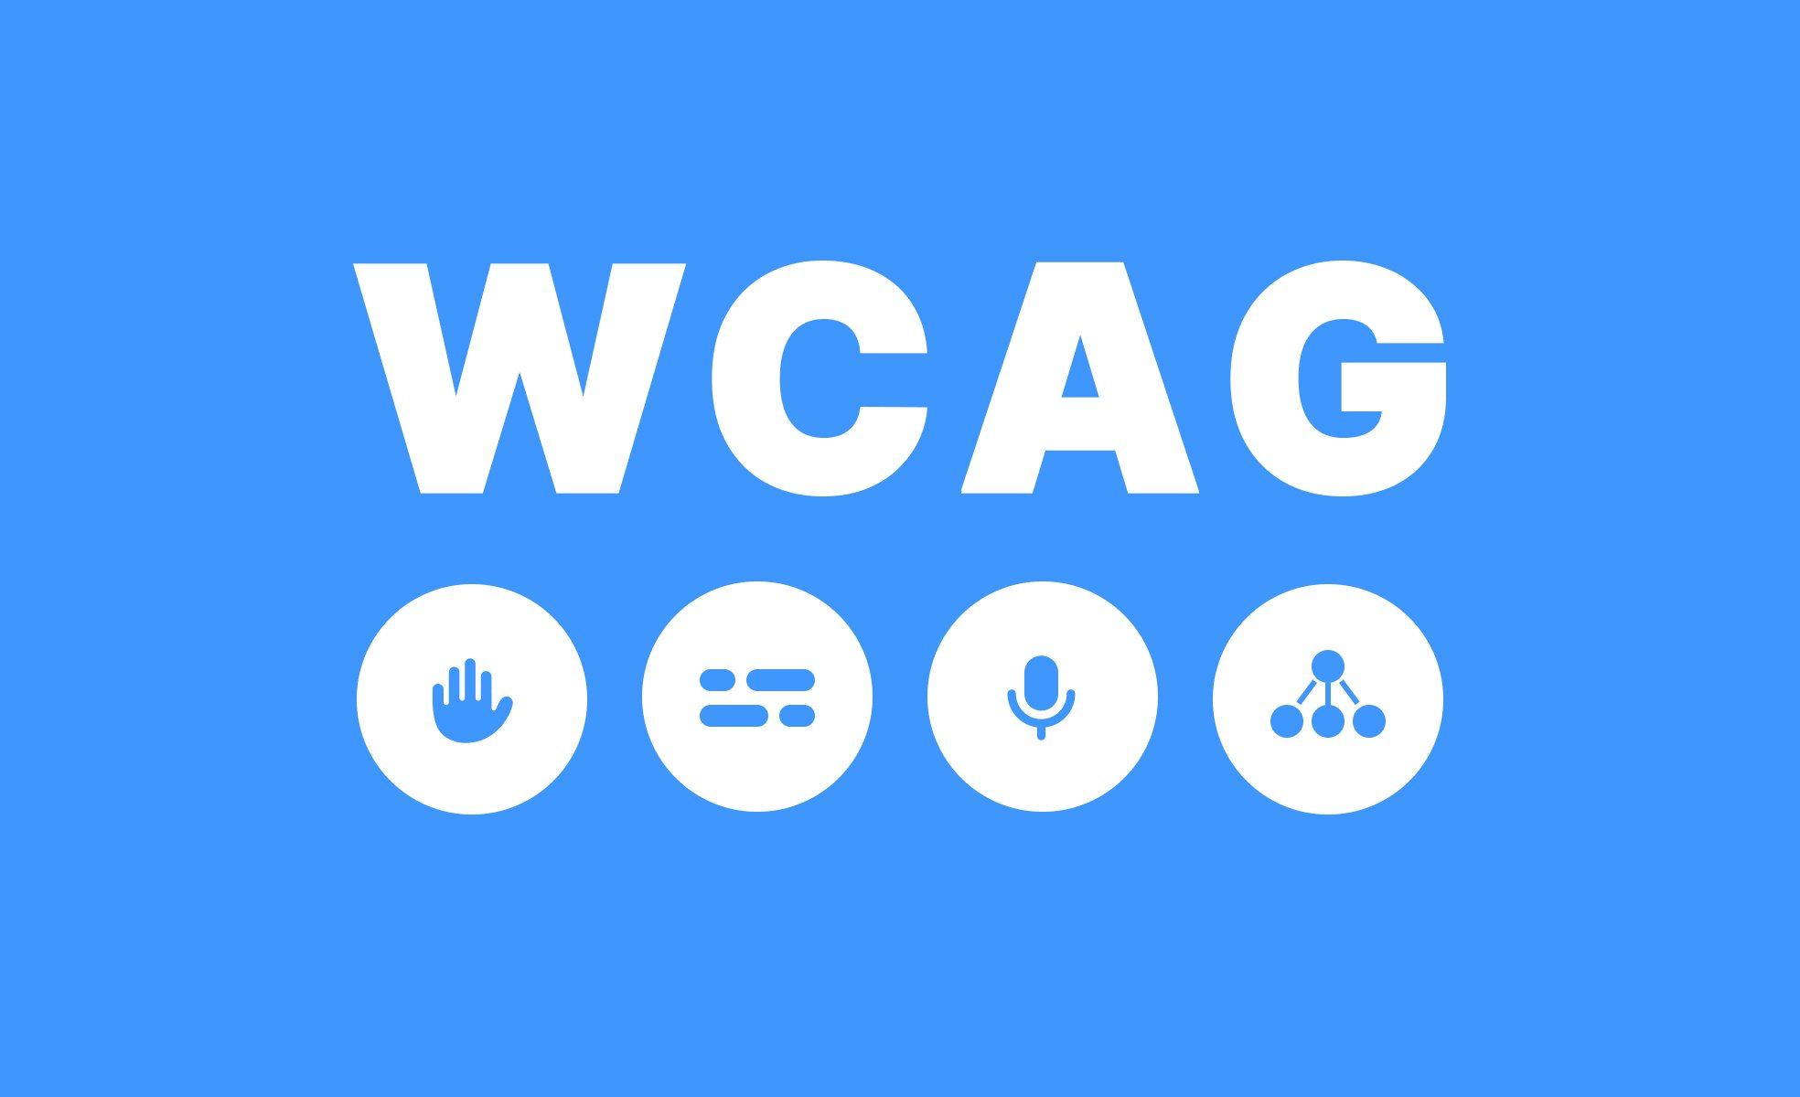

Accessibility guidelines gap
Current standards:
WCAG 2.2 (2023): 4 principles, 3 levels of conformance - web-focused
MCAG (2015): Mobile adaptation - based on WCAG 2.0
WCAG2Mobile (2025): Recent mobile guidance - interpretations only
The problem:
Outdated foundation: MCAG missing WCAG 2.1/2.2 mobile criteria
Implementation void: No practical framework for mobile developers
Knowledge fragmentation: Scattered resources, unclear costs
Result: Mobile developers lack comprehensive accessibility implementation guidance
G. Rovesti - Designing an accessibility learning toolkit
4/17

Slide 5
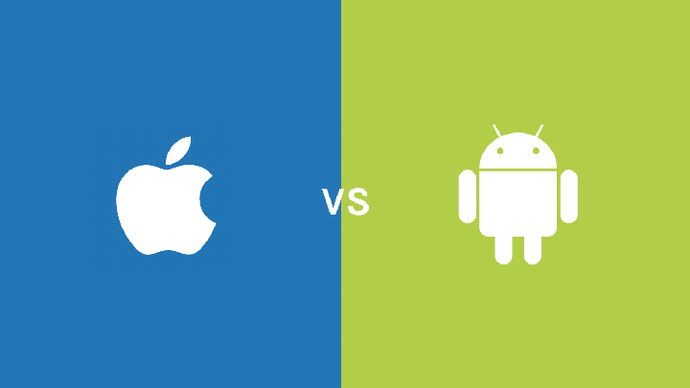
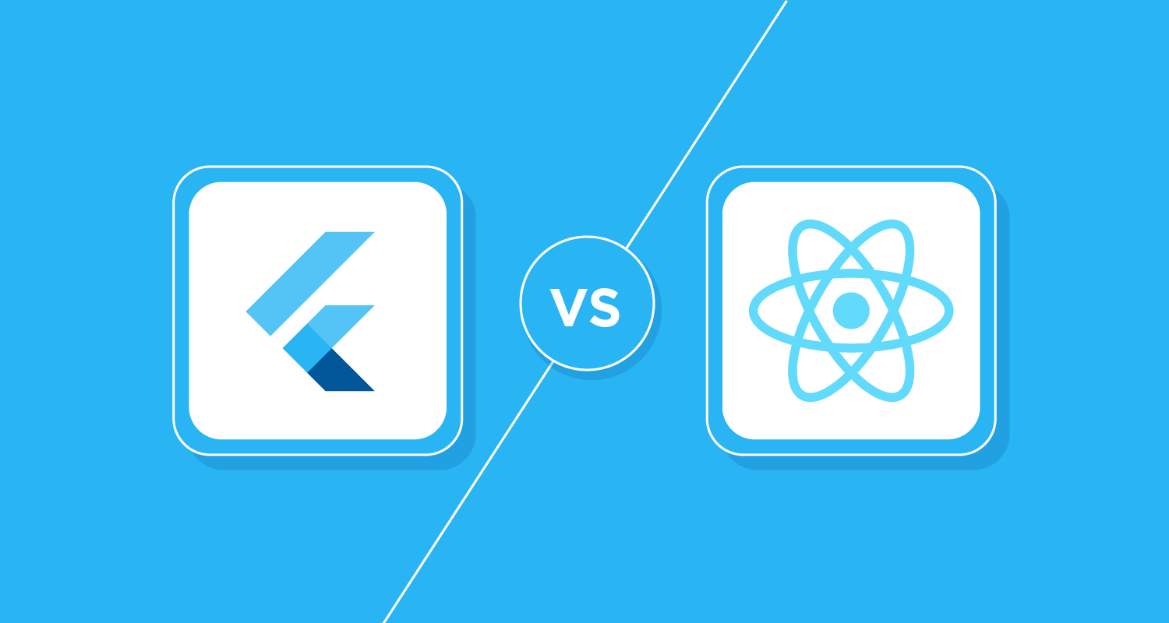
Platform implementation gap
Platform differences:
iOS: VoiceOver, Voice Control, Switch Control
Android: TalkBack, Switch Access, Keyboard navigation
Framework responses:
Flutter: Single accessibility tree, platform adaptation layer
React Native: Platform-specific accessibility props, native bridge
The developer challenge:
Budai (2024): Tested component accessibility → fragmented knowledge
Gap identified: No comprehensive learning resource bridging platforms
G. Rovesti - Designing an accessibility learning toolkit
5/17

Slide 6
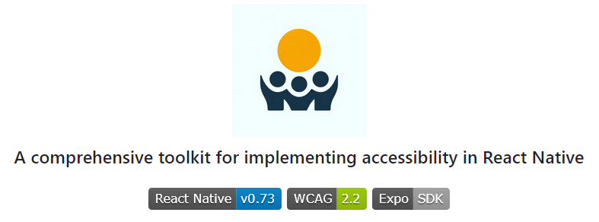
AccessibleHub – Bridging the gap
Research Questions as standard approach:
RQ1: Are React Native components accessible by default?
RQ2: Can non-accessible components be made accessible?
RQ3: What's the implementation cost (code overhead)?
AccessibleHub: React Native application tested on both Android and iOS serving as interactive accessibility manual for mobile developers
Every screen analyzed for accessibility patterns and costs
Educational platform bridging theory to practice
G. Rovesti - Designing an accessibility learning toolkit
6/17

Slide 7
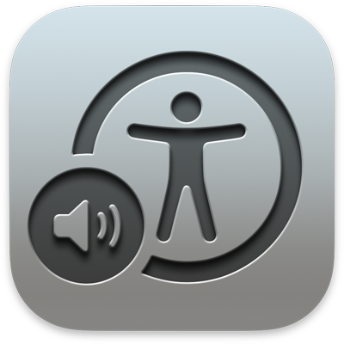

AccessibleHub – Overview
Core sections:
🔧 Accessible Components: UI implementations with copyable code
📚 Best Practices: Educational content on accessibility challenges
🛠️ Tools - Settings: Resource catalog for testing and common settings
📊 Framework Comparison: Evidence-based evaluation methodology
👥 Instruction & Community: Social learning & collaborative resources
Research innovation: Every screen analyzed as case study
- Dual methodology: Both research vehicle & educational tool
- 20+ components tested with TalkBack and VoiceOver
- Cross-platform validation ensuring patterns work universally
G. Rovesti - Designing an accessibility learning toolkit
7/17

Slide 8
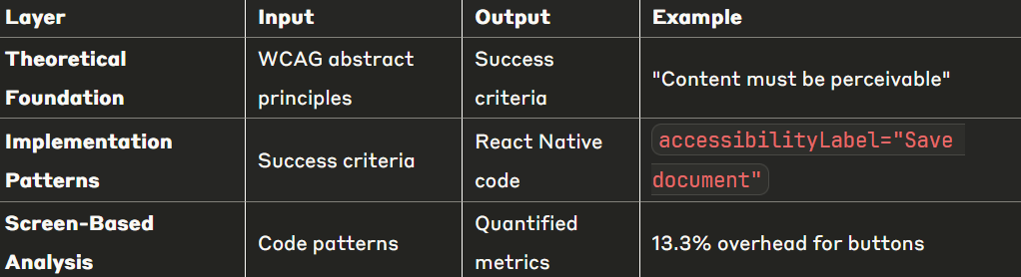
Systematic analysis approach
The transformation challenge: WCAG guidelines are abstract and difficult to implement directly in mobile code
Basic workflow - Enabling data-driven accessibility decisions
Abstract WCAG → Implementation Patterns →
Quantified Metrics → Educational Platform
G. Rovesti - Designing an accessibility learning toolkit
8/17

Slide 9
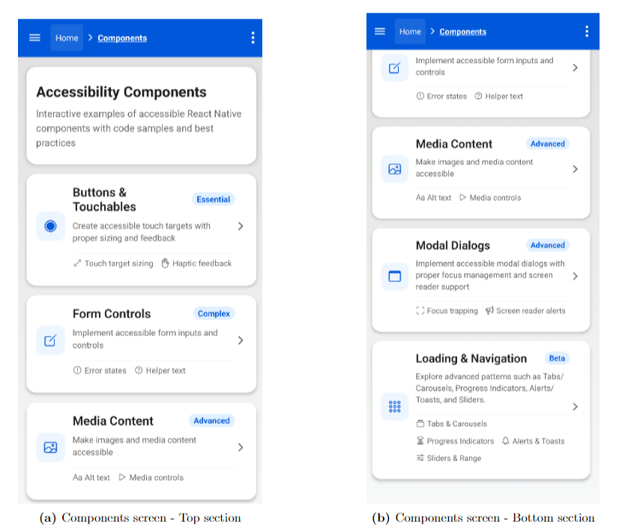
Systematic analysis – Example (1)
G. Rovesti - Designing an accessibility learning toolkit
9/17

Slide 10
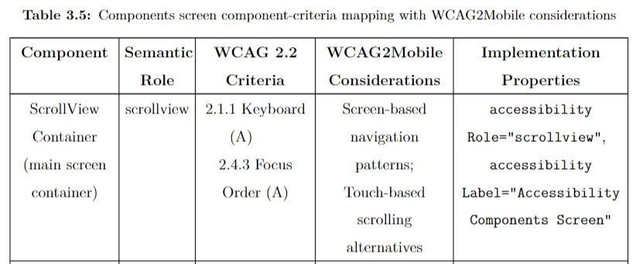
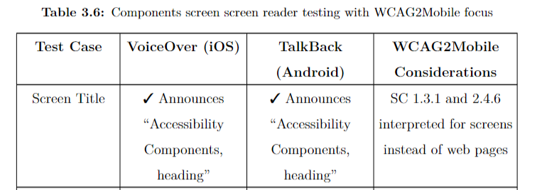
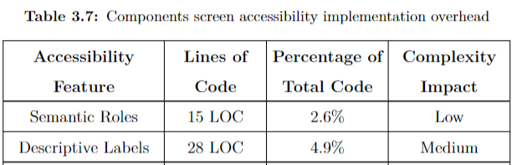
Systematic analysis – Example (2)
G. Rovesti - Designing an accessibility learning toolkit
10/17

Slide 11
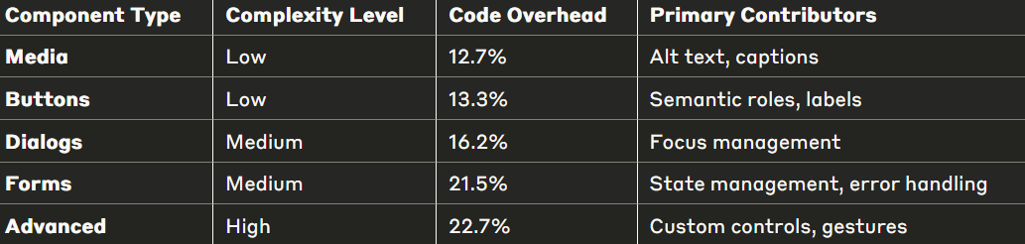
Accessibility implementation costs
Key finding: Accessibility implementation requires 12-23% additional code across component types
Critical insights:
Even complex components stay under 25%
Correlation between interaction complexity and implementation cost
Manageable overhead for significant usability improvements
First quantitative framework for mobile accessibility cost assessment
G. Rovesti - Designing an accessibility learning toolkit
11/17

Slide 12

Formal evaluation metrics
Innovation: Evidence-based methodology for quantifying mobile accessibility implementation across frameworks
🔢 Implementation Overhead (IMO)
Direct code cost measurement for equivalent functionality
📱 Screen Reader Support Score (SRSS):
Likert scale based on VoiceOver/TalkBack functionality
✅ WCAG Compliance Ratio (WCR):
Standards adherence tracking (A/AA/AAA levels)
⚙️ Complexity Impact Factor (CIF):
Development difficulty classification (Low/Medium/High)
⏱️ Development Time Estimate (DTE):
Resource planning with complexity adjustments
G. Rovesti - Designing an accessibility learning toolkit
13/17

Slide 13
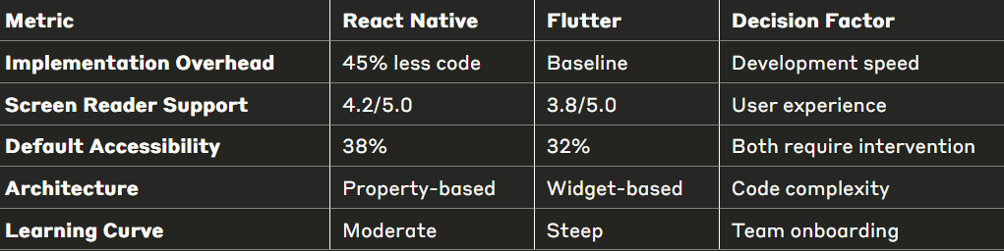
Framework comparison
Architecture differences:
React Native: Property-based model (accessibilityLabel, accessibilityRole)
Flutter: Widget-based approach (explicit Semantics wrappers)
G. Rovesti - Designing an accessibility learning toolkit
14/17

Slide 14
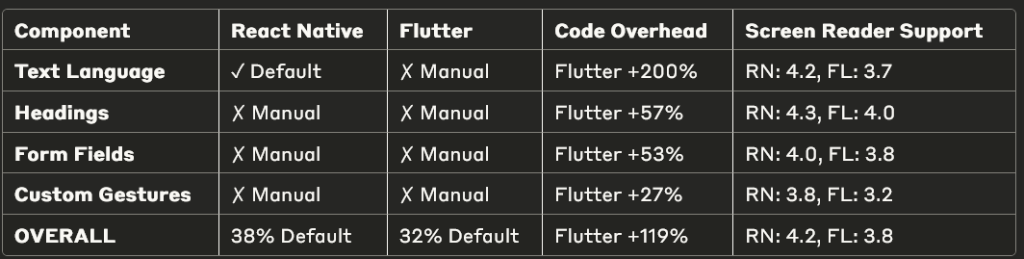
Framework comparison results (1)
Key Patterns Identified:
Text language declaration: Largest overhead difference (Flutter +200%)
Custom gestures: Smallest gap (Flutter +27%) - both frameworks struggle
Default accessibility: React Native provides more out-of-box features (38% vs 32%)
Screen reader consistency: React Native scores higher across all component types
G. Rovesti - Designing an accessibility learning toolkit
15/17

Slide 15
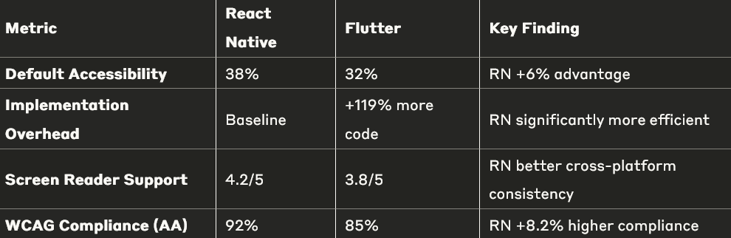
Framework comparison results (2)
Critical insights:
Choose React Native when: Rapid development, web accessibility experience, tight deadlines
Choose Flutter when: Complex custom components, long-term maintenance teams, granular control
G. Rovesti - Designing an accessibility learning toolkit
16/17

Slide 16


Research impact and conclusions
Key contributions:
- Extended research framework from Flutter-only to comparative analysis
- First quantitative framework for mobile accessibility cost assessment
- 45% implementation overhead reduction with React Native
- Systematic methodology bridging WCAG theory to mobile practice
Research answers:
- RQ1: Neither framework accessible by default (38% vs 32%)
- RQ2: Both achieve 100% WCAG compliance with proper implementation
- RQ3: React Native requires 45% less code for equivalent accessibility
G. Rovesti - Designing an accessibility learning toolkit
17/17

